Slide 1
TERMINILOGY

Slide 2
ANATOMY DEFINED
Anatomy
  the study of structure and the relationships among structures.
Subdivisions
  surface anatomy, gross anatomy, radiological anatomy, embryology, cytology, histology and pathological anatomy

Slide 3
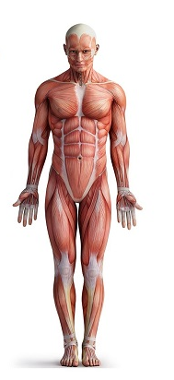
anatomical position
body erect; head, eyes, toes
directed forward;
upper limbs at the
side of the body,
with palms directed forward

Slide 4
DIRECTIONAL TERMS
Directional terms are used to precisely locate one part of the body relative to another and to reduce length of explanations.

Slide 5
1. medial - nearer or towards the median plane
2. lateral - further from the median plane
3. anterior or ventral - nearer to the front of the body
4. posterior or dorsal - nearer to the back of the body
5. superior or cephalic - nearer to the top of the head
6. inferior or caudal - nearer to the bottom of the feet DIRECTIONS
7. superficial - towards the surface of an organ or the body
8. deep - towards the center of an organ or the body
9. proximal - nearer the point of origin or attachment
10. distal - further from the point of origin or attachment

Slide 6
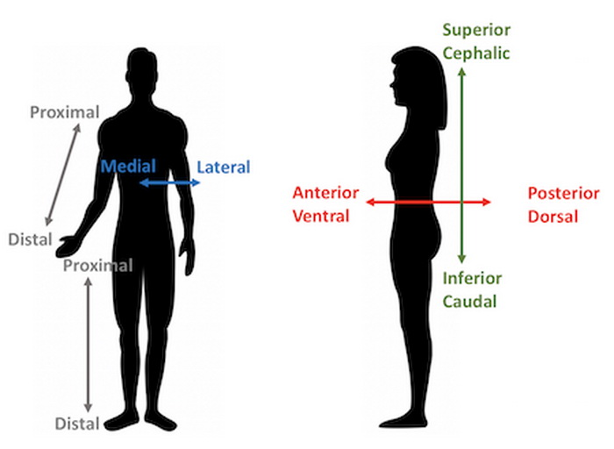

Slide 7
Nervous system
Peripheral nervous system
Central nervous system

Slide 8
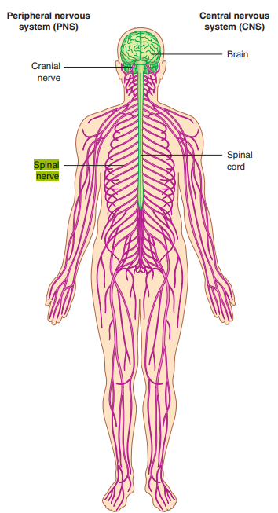
Central nervous system
Central part: Brain and spinal cord.
Peripheral part composed of 12 pairs cranial and 31 pairs spinal nerves.
The peripheral nervous system is divided into the somatic nervous system and the autonomic nervous system.

Slide 9
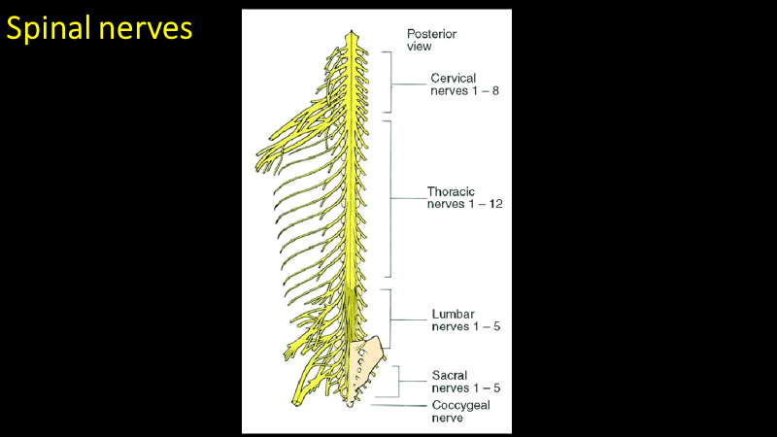

Slide 10
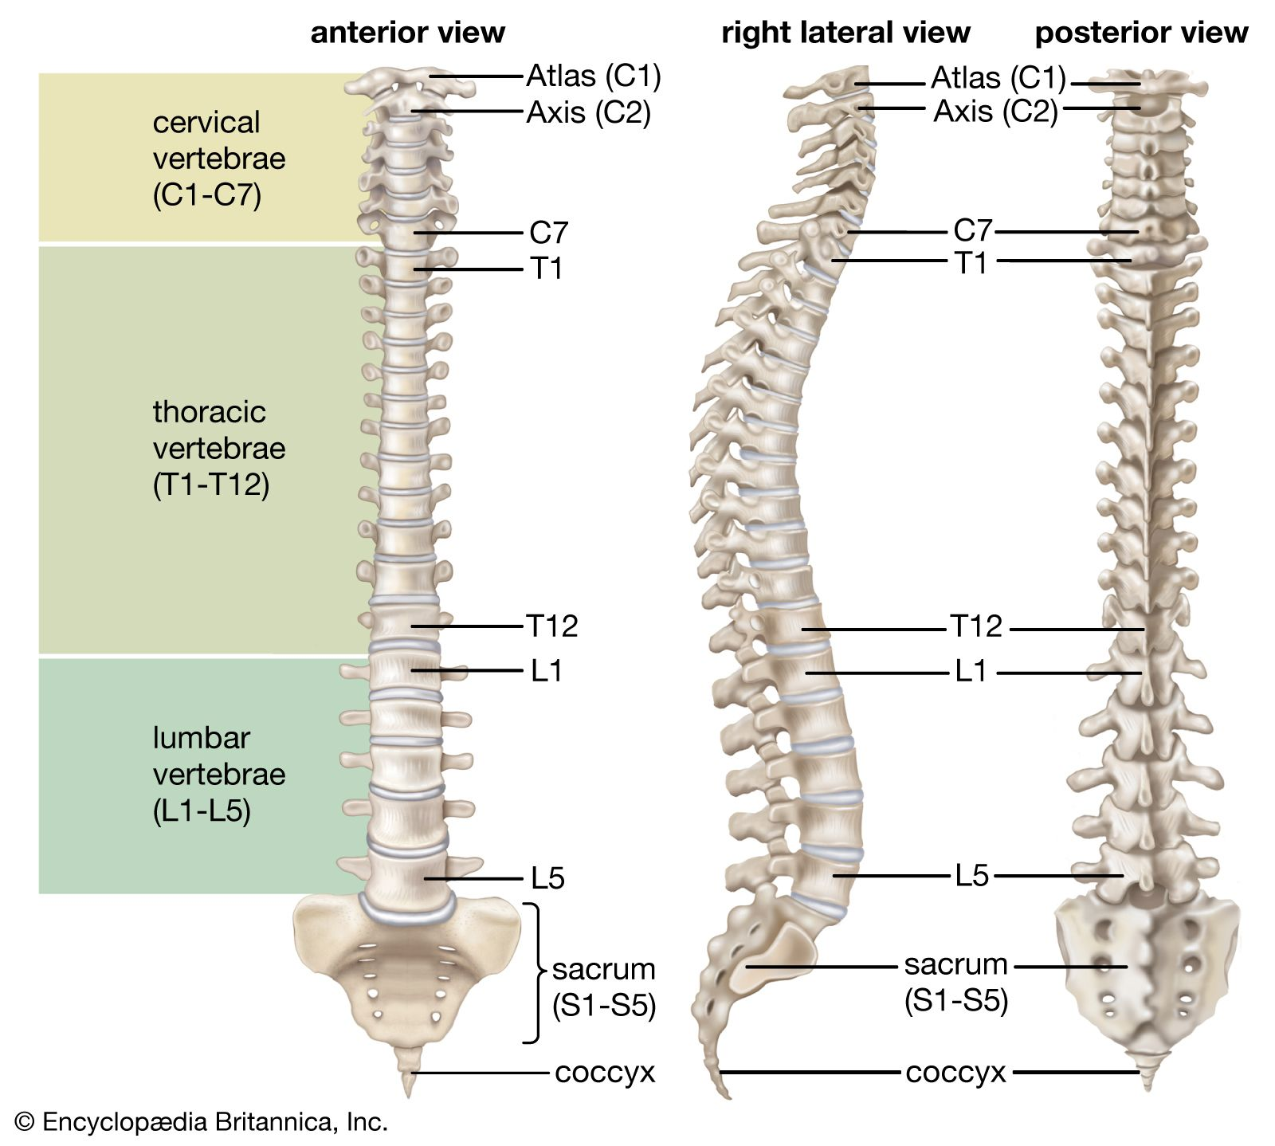

Slide 11
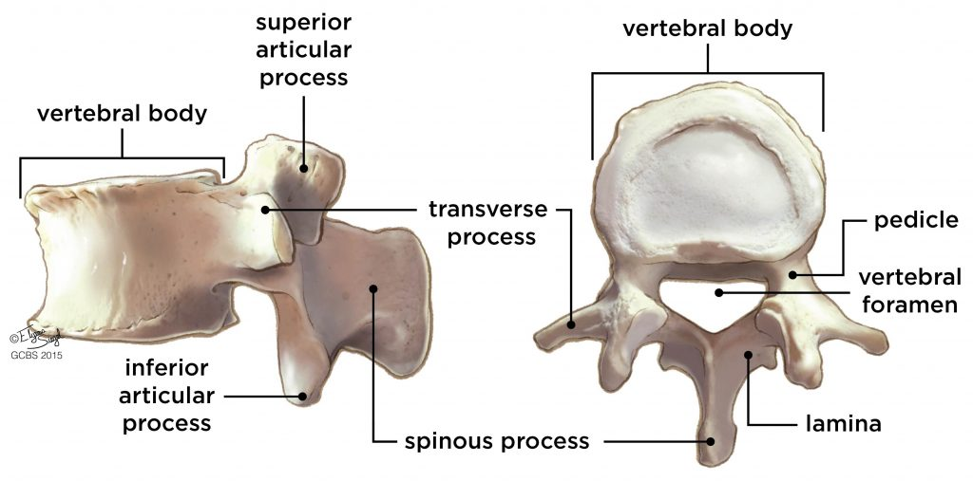

Slide 12
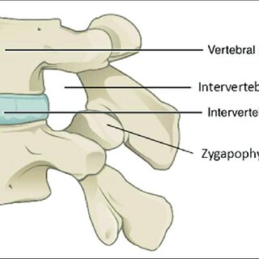
Intervertebral foramen

Slide 13
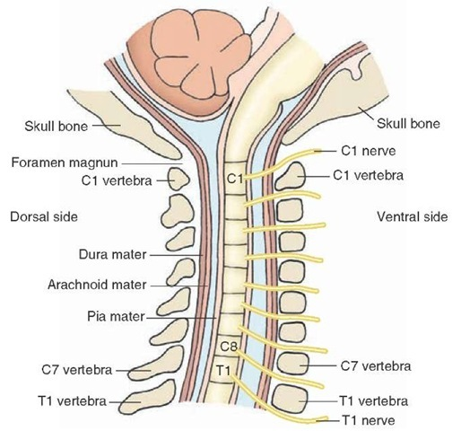
exit of spinal nerves from the vertebral column

Slide 14
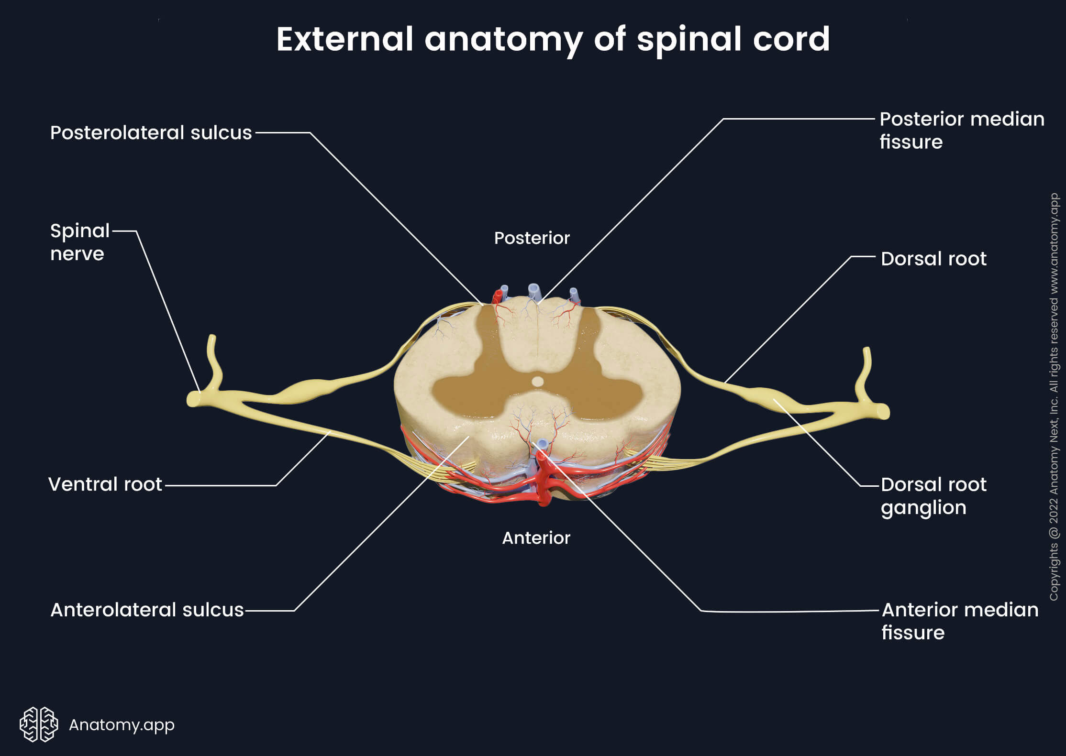

Slide 15
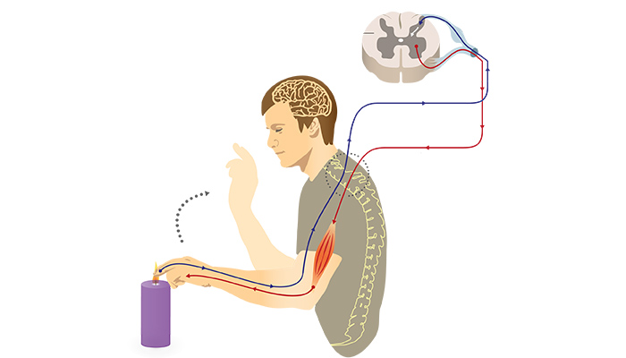
Somatic nervous system

Slide 16
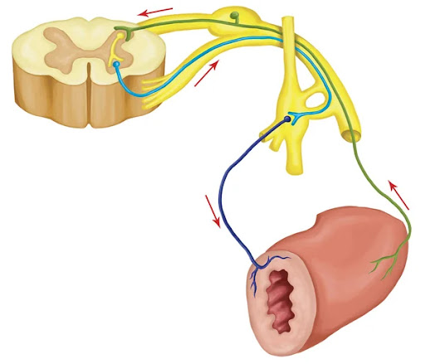
Visceral nervous system

Slide 17
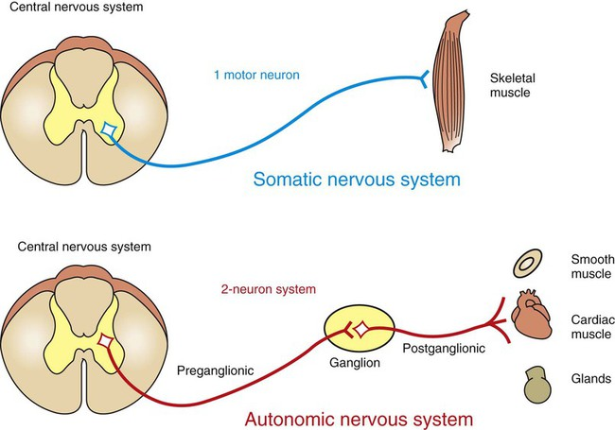

Slide 18
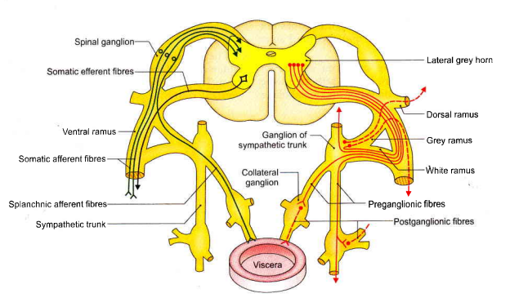

Slide 19
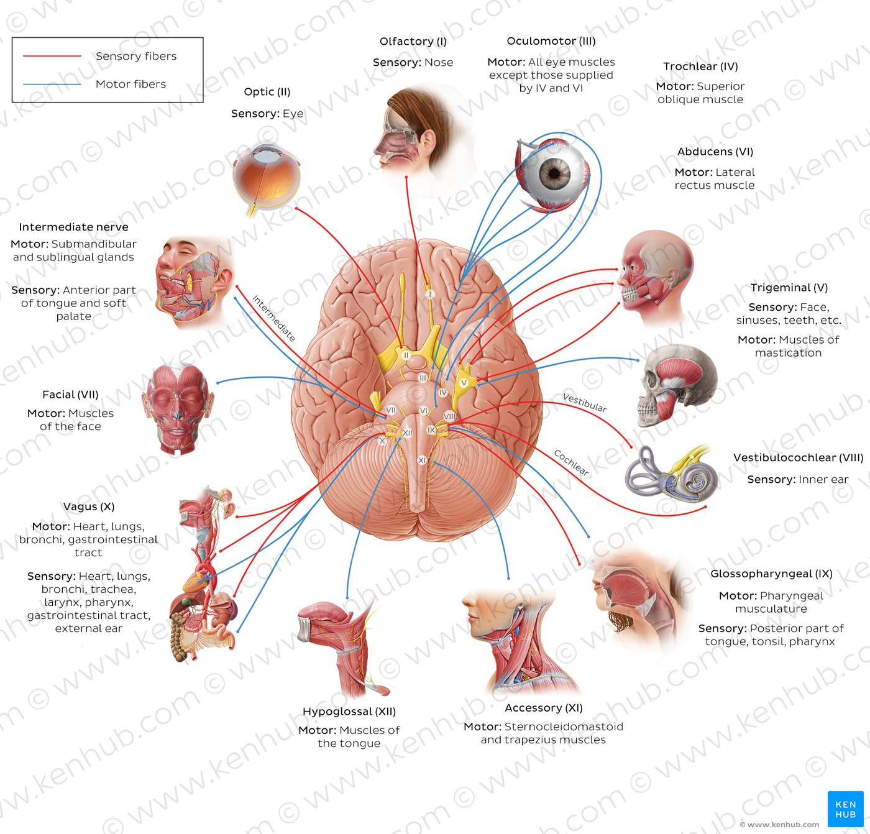
Cranial nerves

Slide 20
Anastomosis
The circulatory anastomosis is further divided into arterial and venous anastomosis. Arterial anastomosis includes actual arterial anastomosis and potential arterial anastomosis.

Slide 21
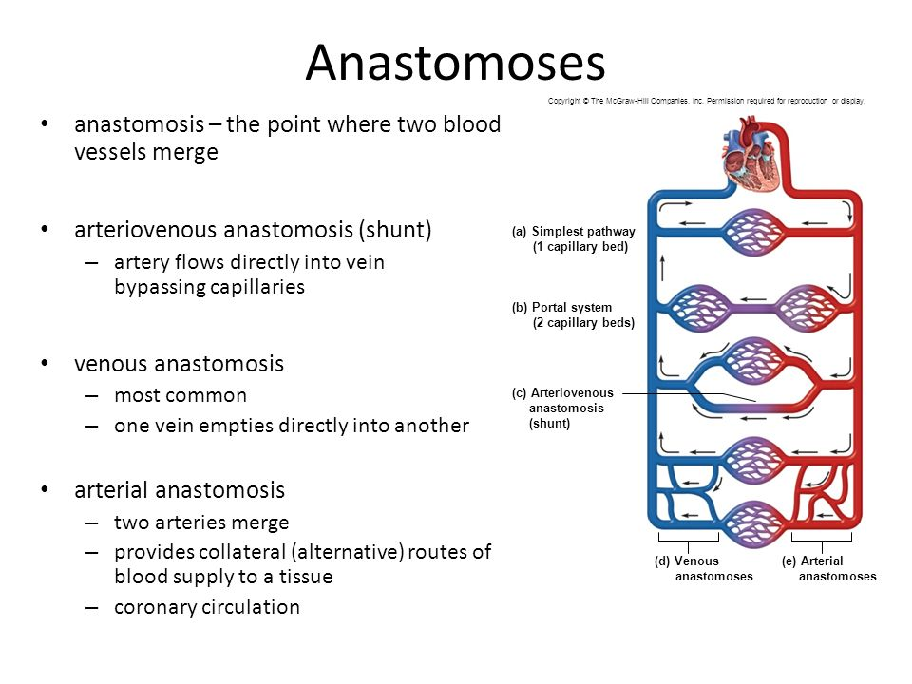

Slide 22
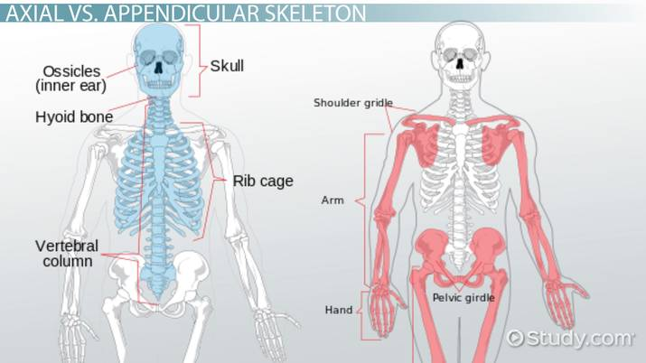

Slide 23
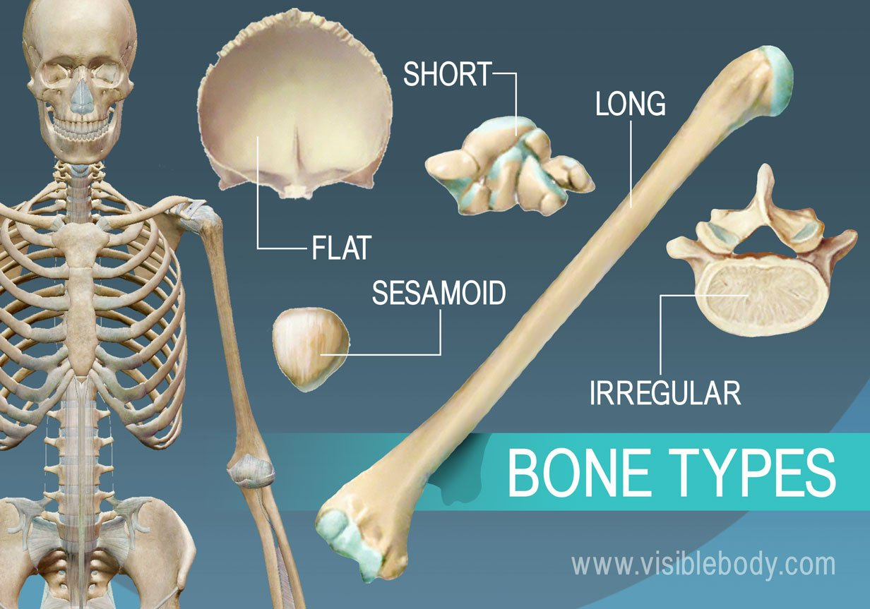

Slide 24
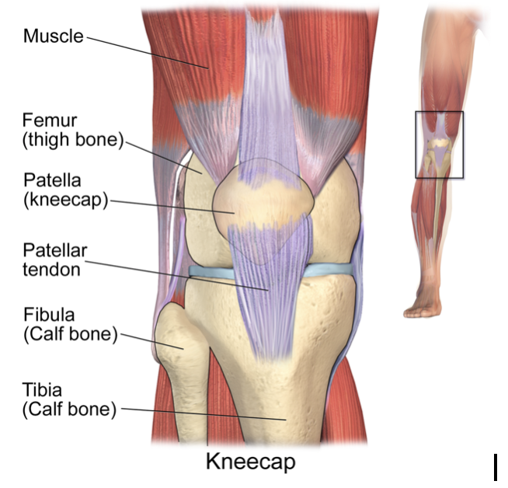
sesamoid - bones which develop within a tendon; patella, pisiform

Slide 25
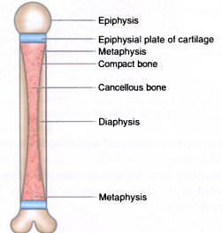
Parts of young bone

Slide 26
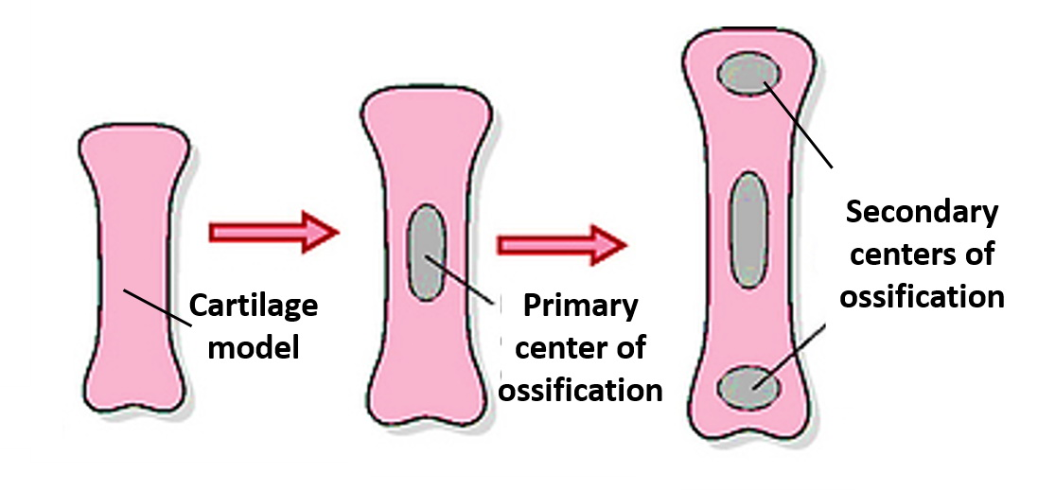

Slide 27
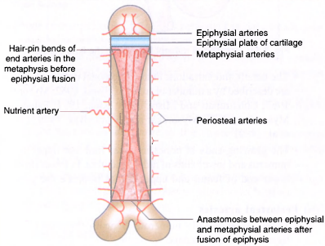
Blood supply of bone

Slide 28
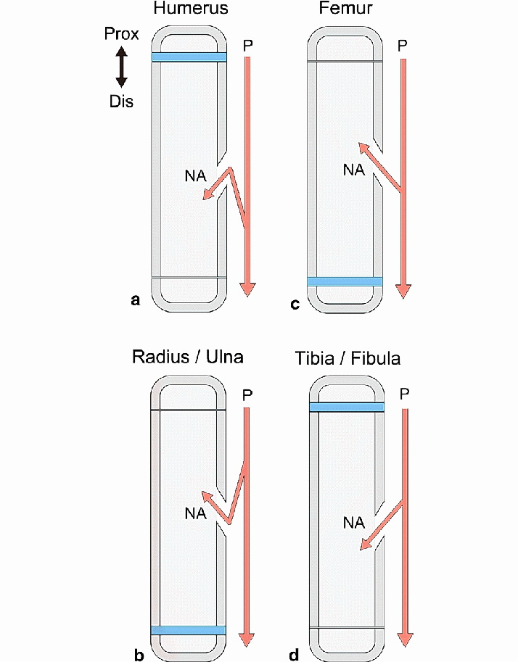

Slide 29
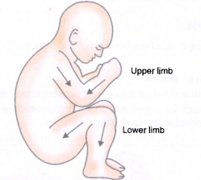

Slide 30
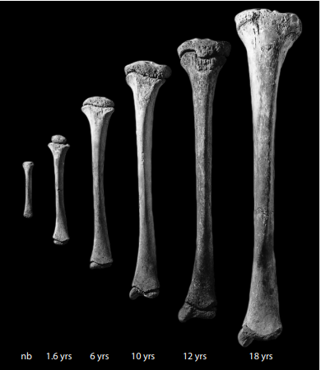

Slide 31
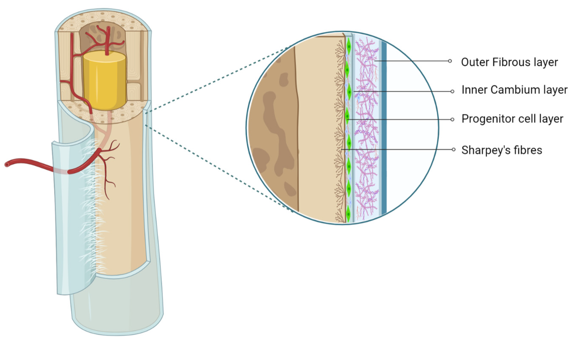
Periosteum

Slide 32
Planes

Slide 33
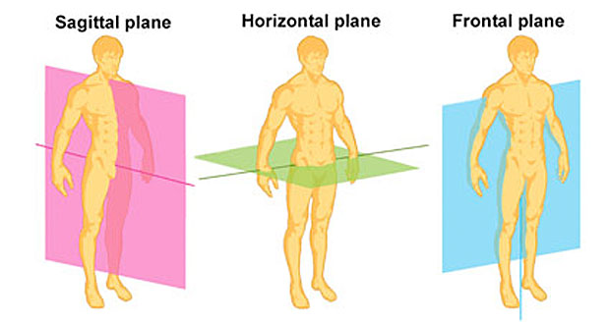

Slide 34
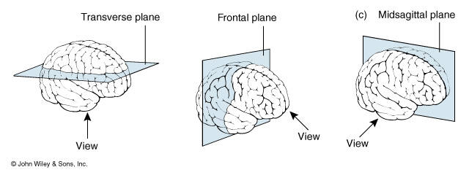
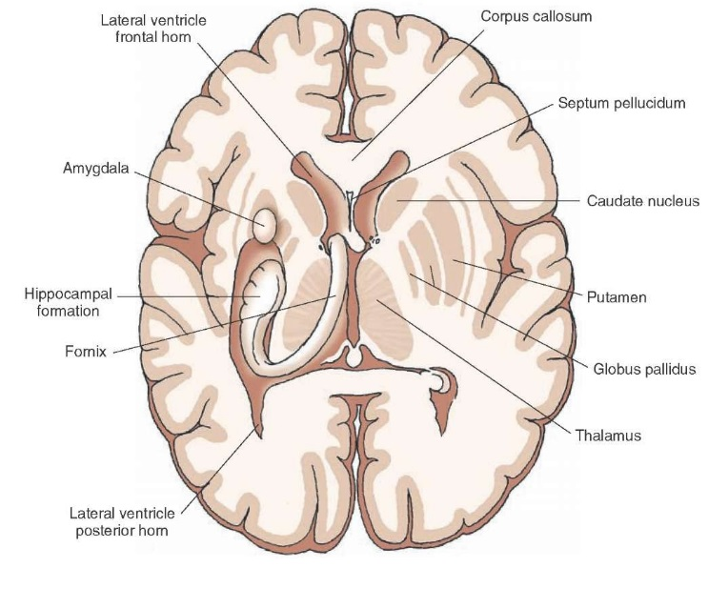
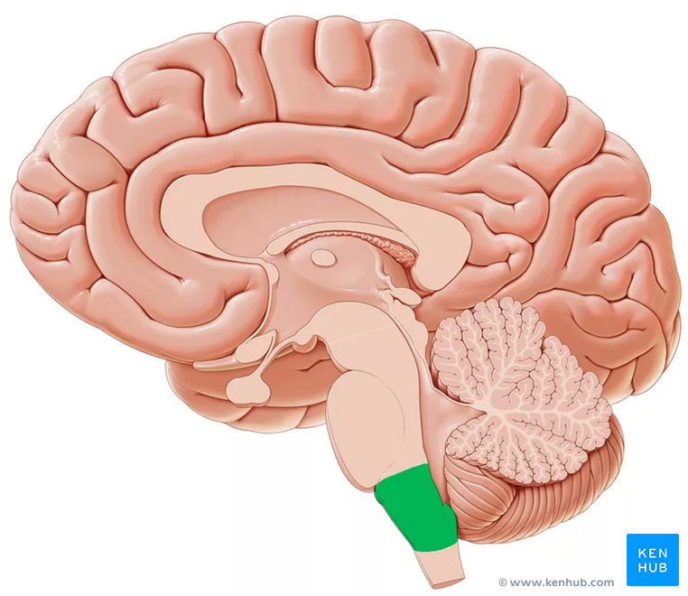
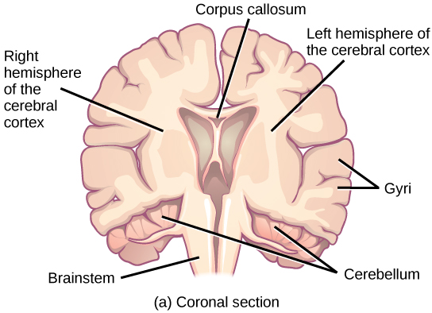

Slide 35
MOVEMENTS

Slide 36
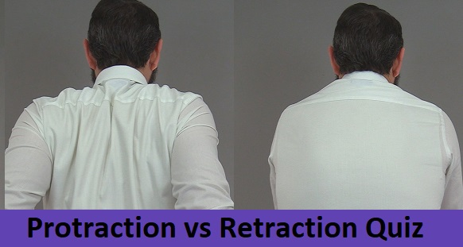
Shoulder movements

Slide 37
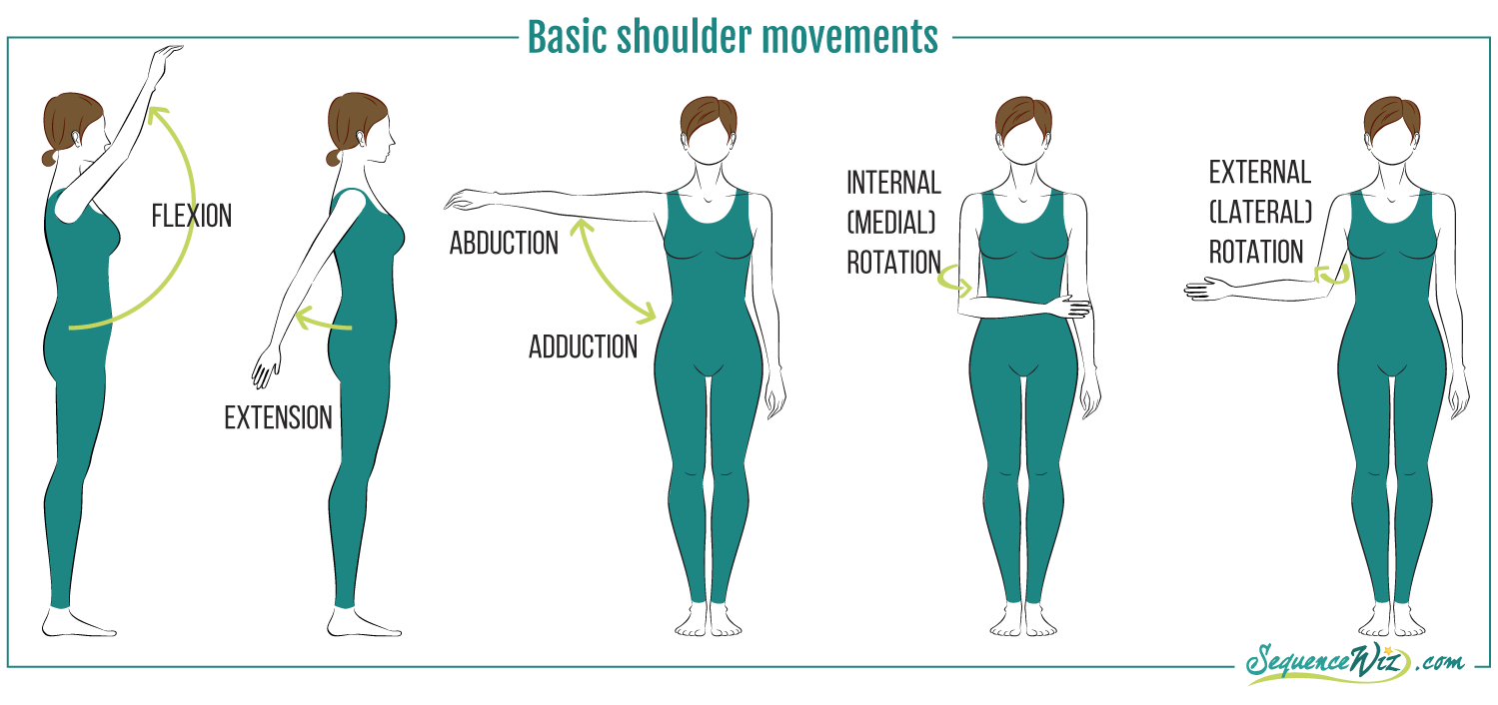
Types of movement

Slide 38
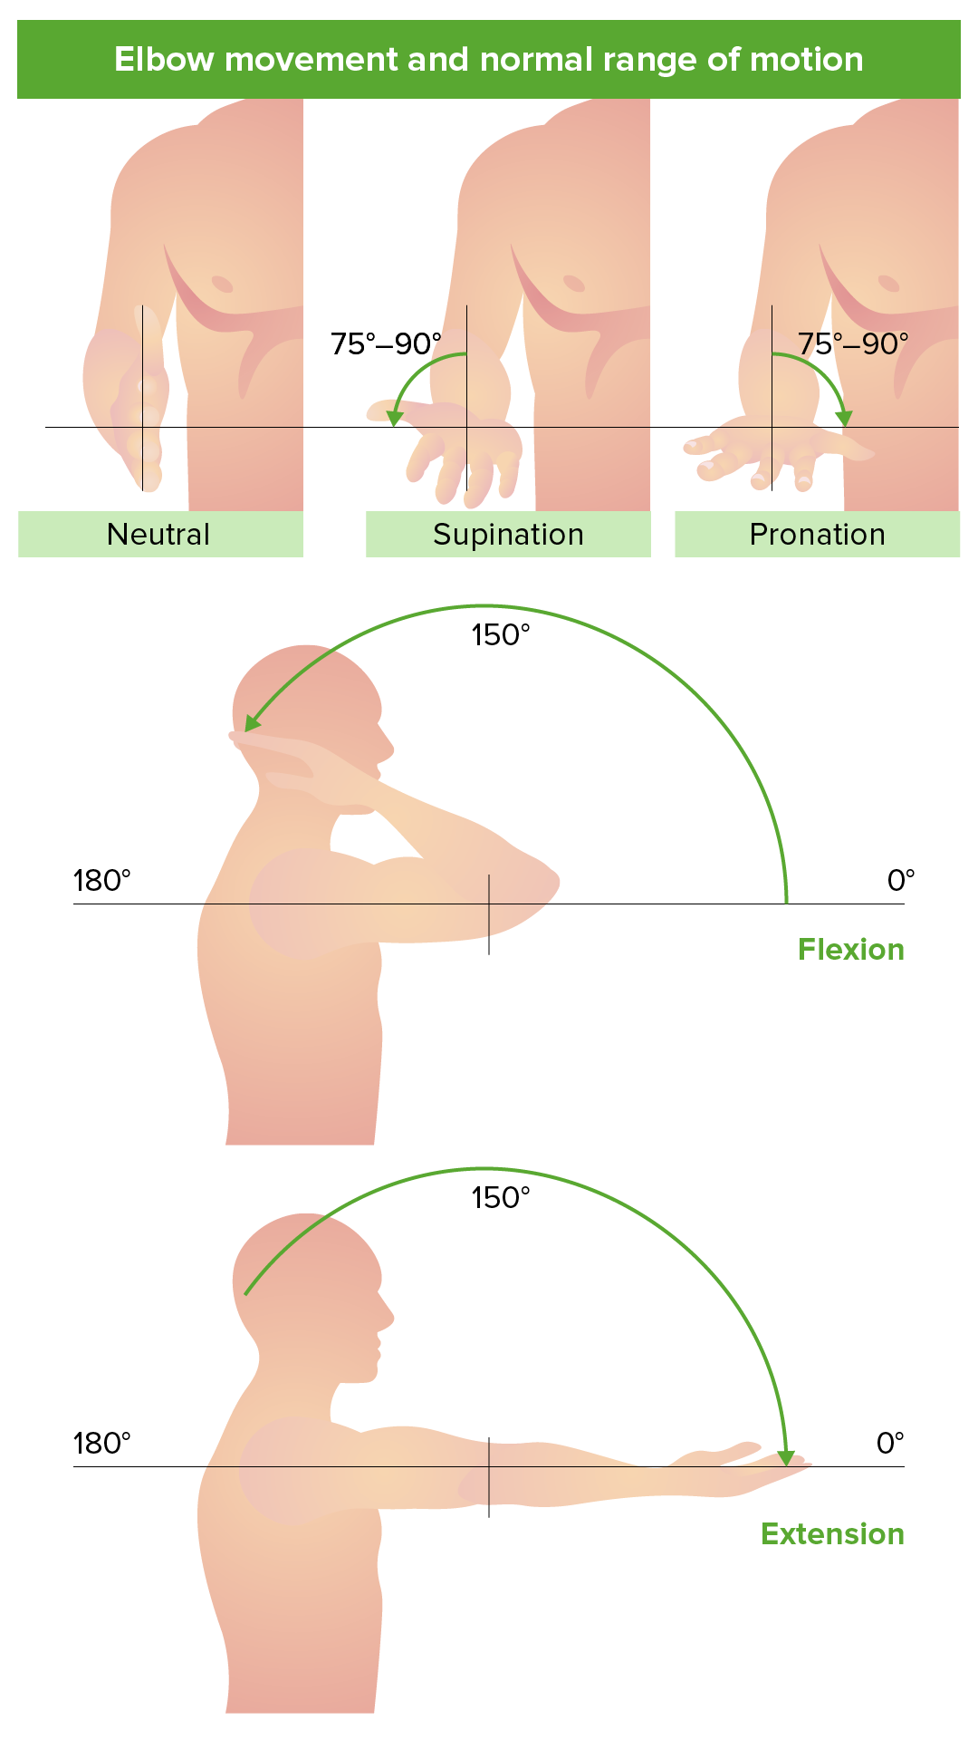
Elbow & forearm movements

Slide 39
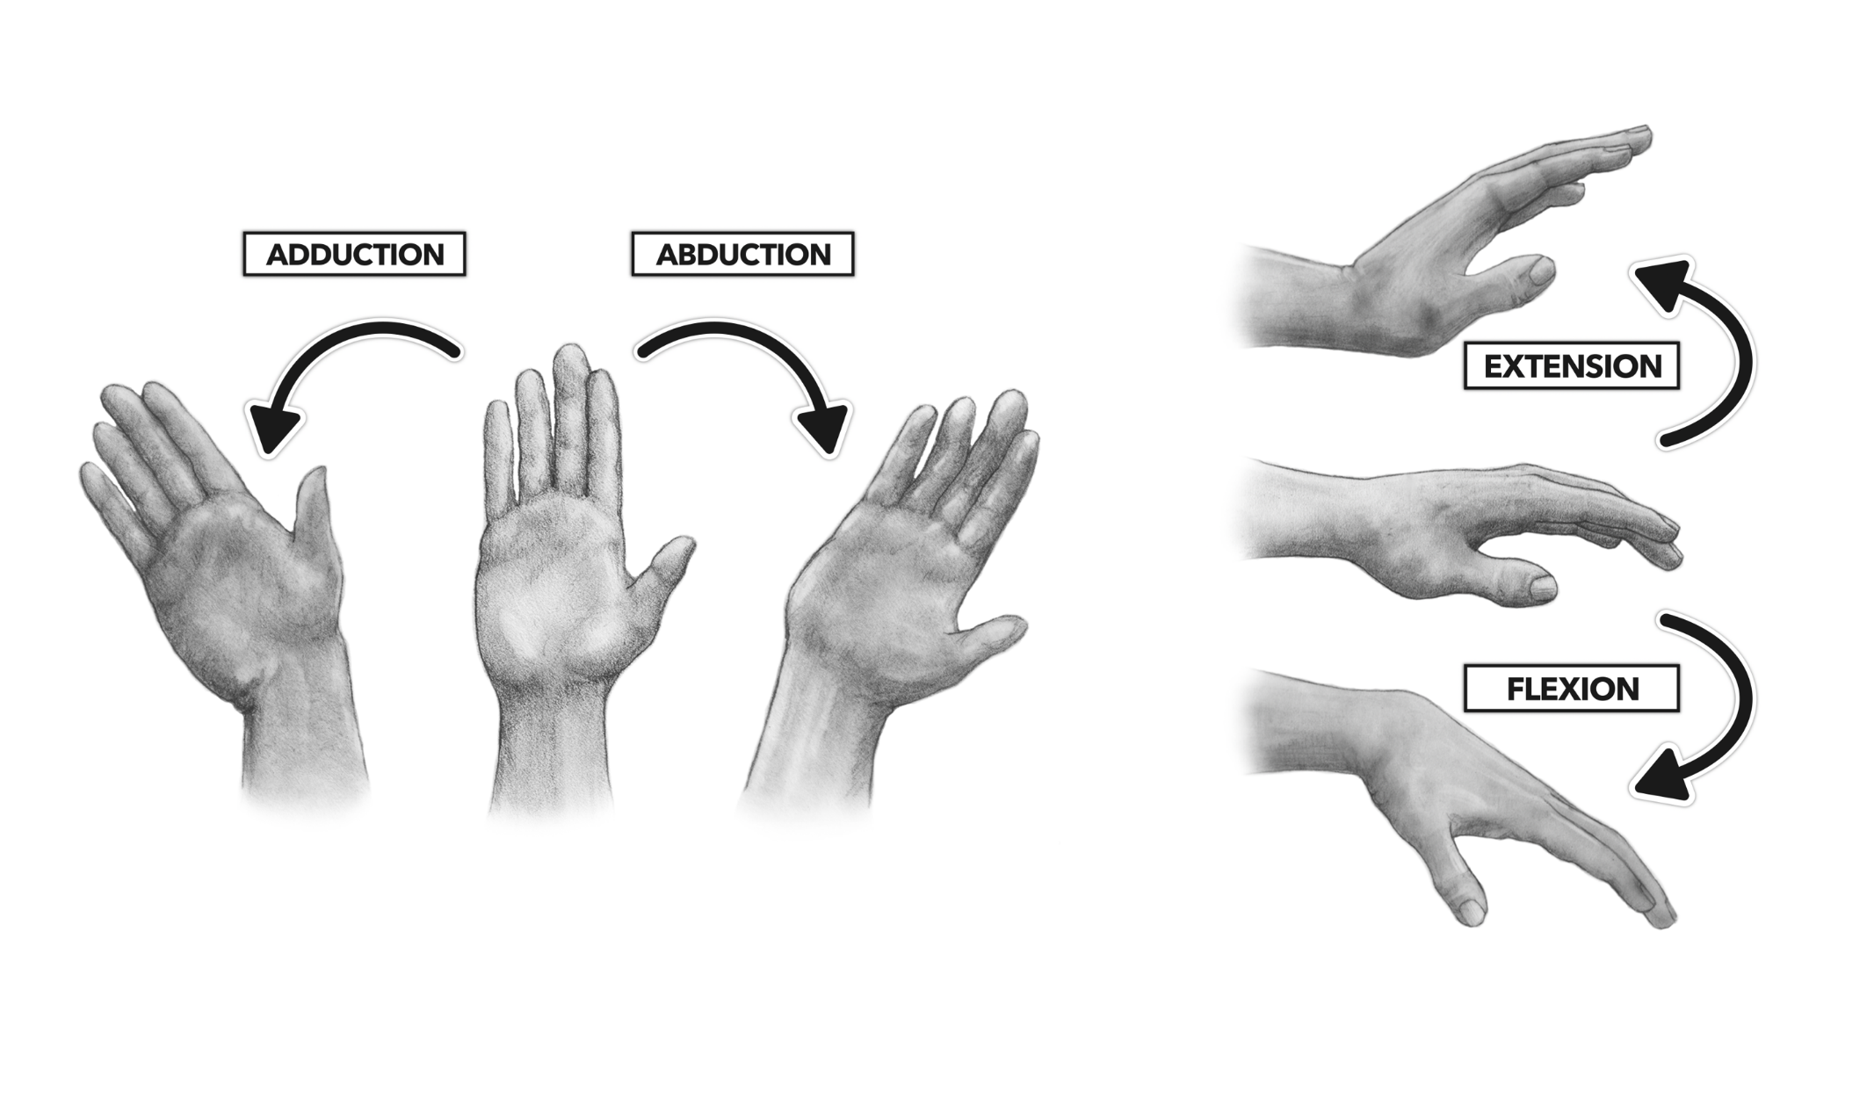
Wrist movements

Slide 40
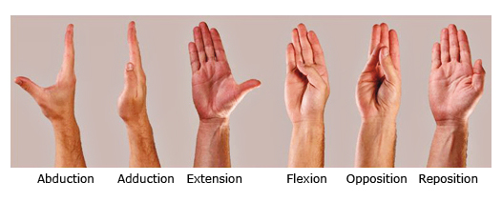
Thumb movements

Slide 41
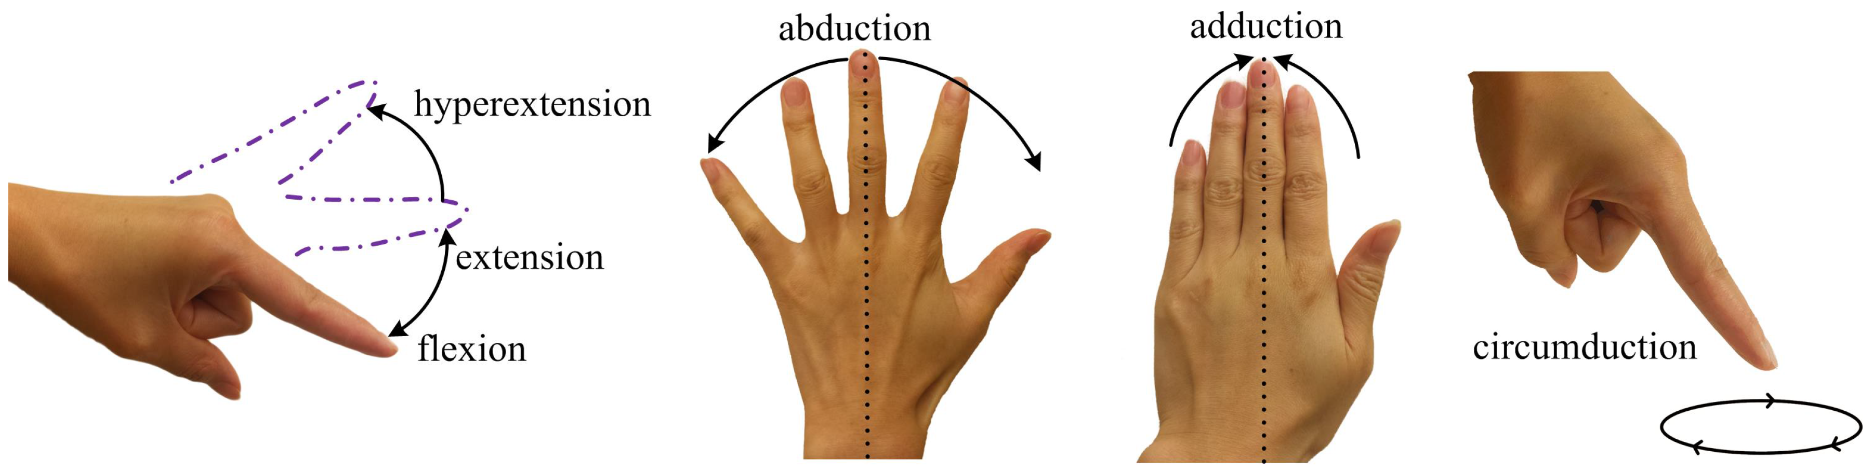
Finger movements

Slide 42
Muscle names - muscles are named for the following:
a] shape
b] action
c] attachment
d] location

Slide 43
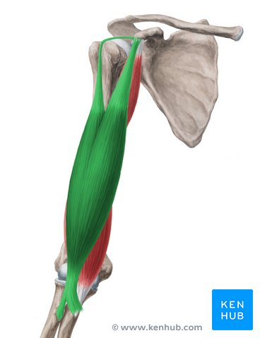
biceps brachii muscle

Slide 44
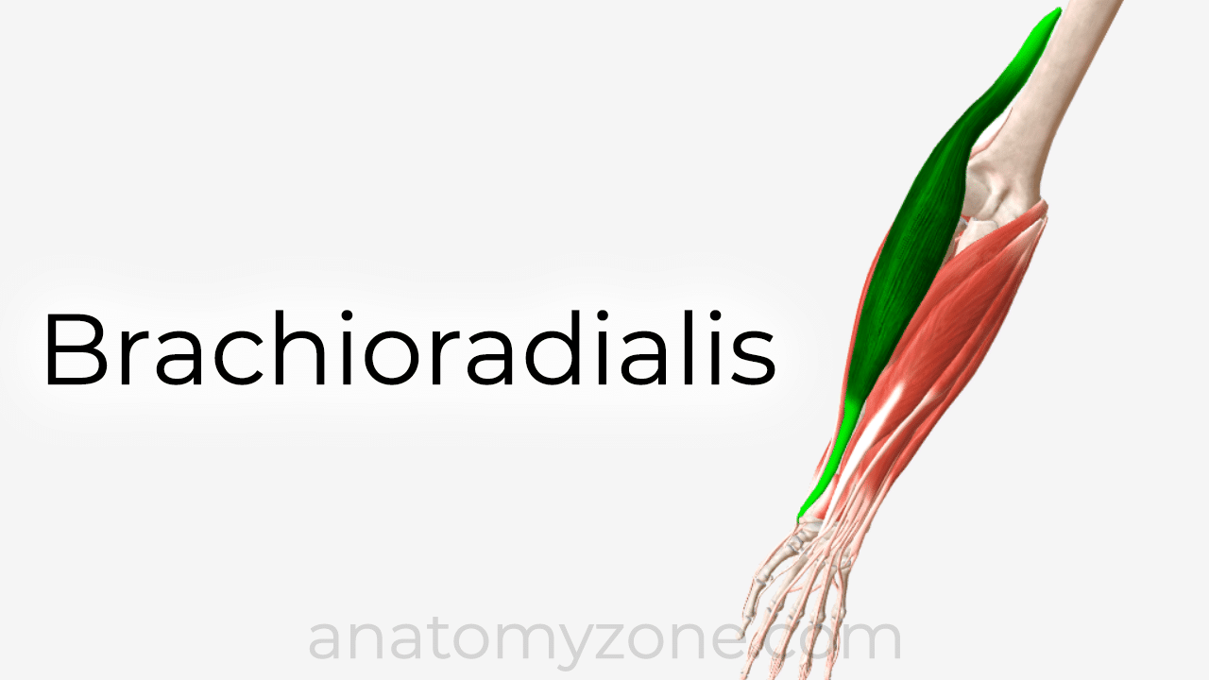

Slide 45
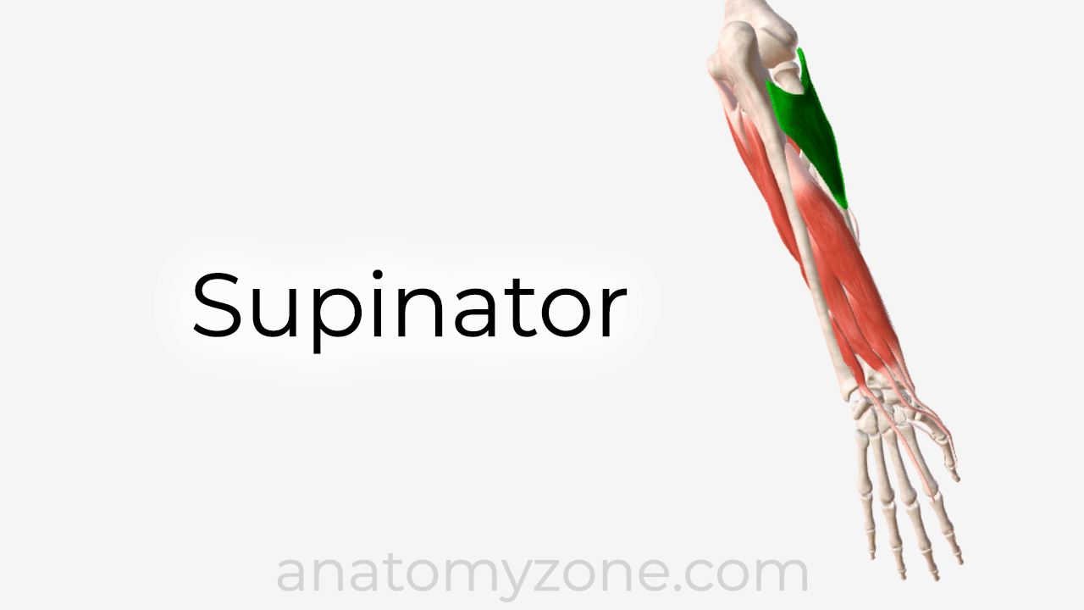

Slide 46
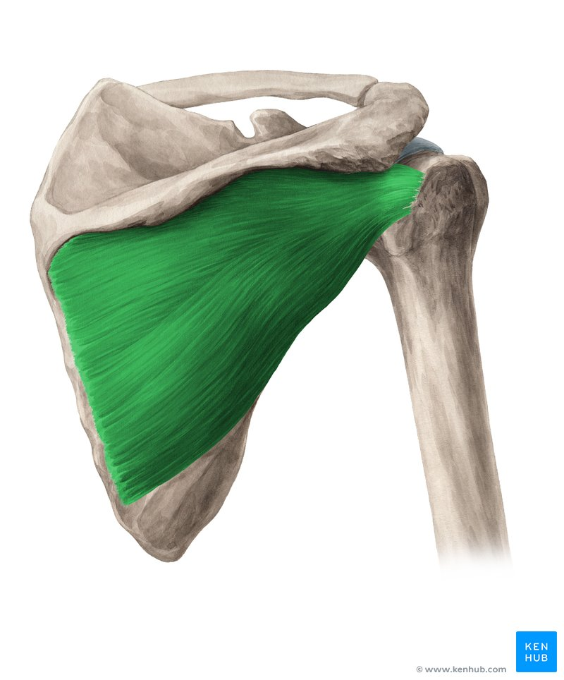
Infraspinatus muscle

Slide 47
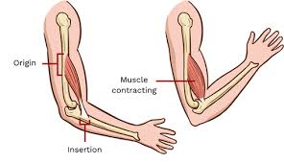

Slide 48
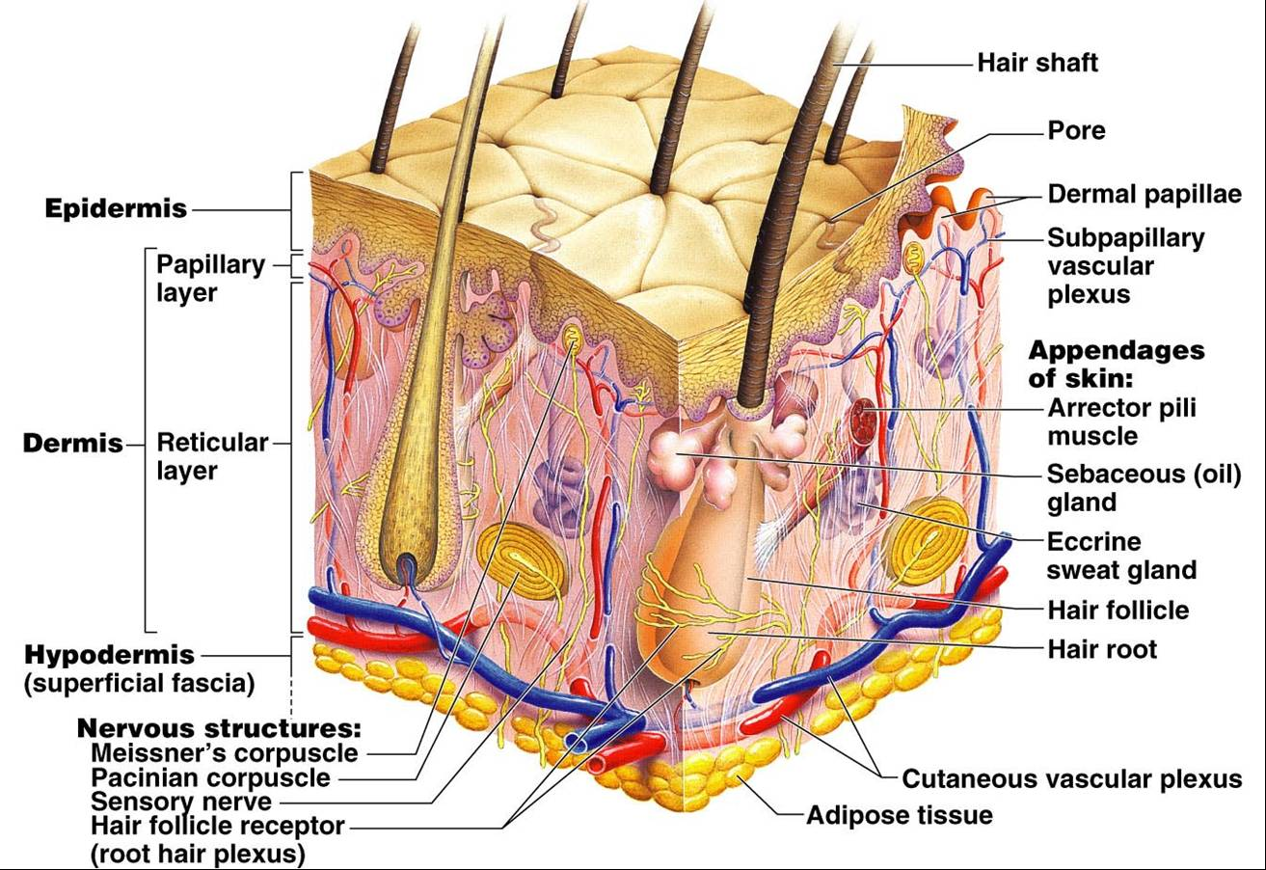
Superficial fascia, the thin layer of loose fatty connective tissue underlying the dermis and binding it to the parts beneath. It is called also HYPODERMIS.

Slide 49
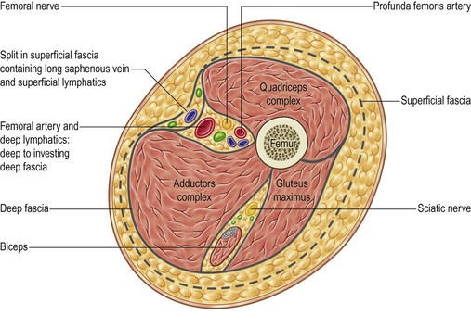
Deep fascia, a layer of dense connective tissue which can surround individual muscles and also aurround a groups of muscles to separate into fascial compartements

Slide 50
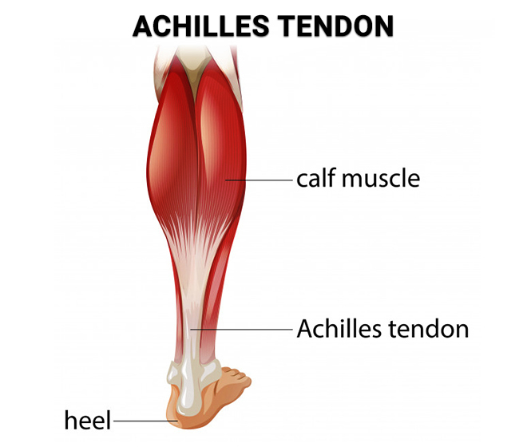
Tendon

Slide 51
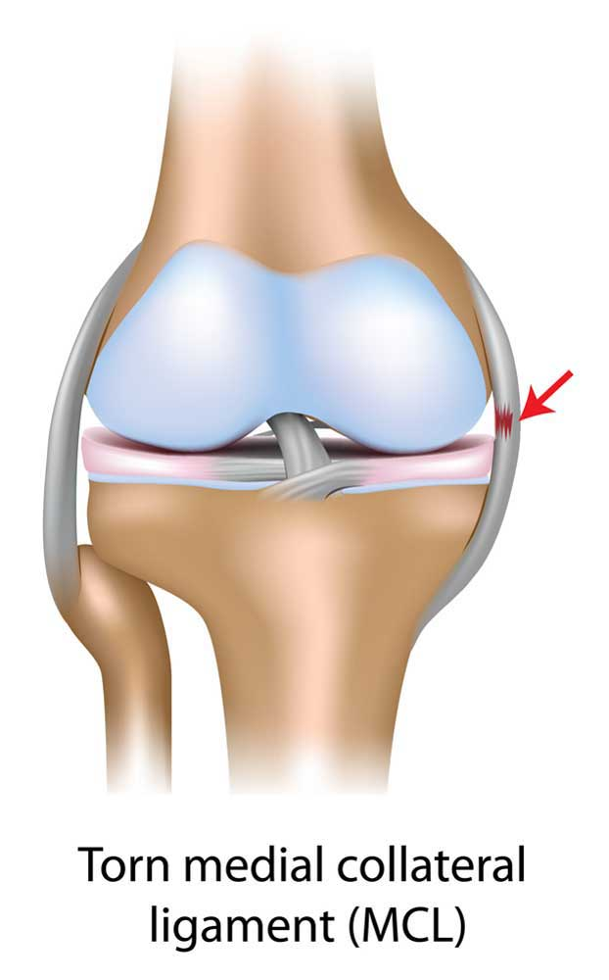
Ligament

Slide 52
Joints
A joint is the part of the body where two or more bones meet to allow movement.
There are four structural classifications of joints:
FIBROUS, CARTILAGINOUS, SYNOVIAL and FACET joints

Slide 53
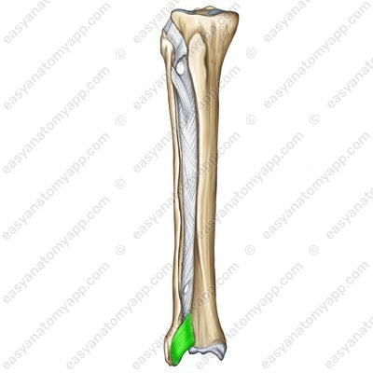
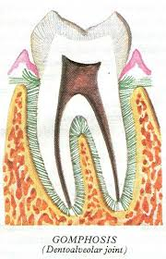
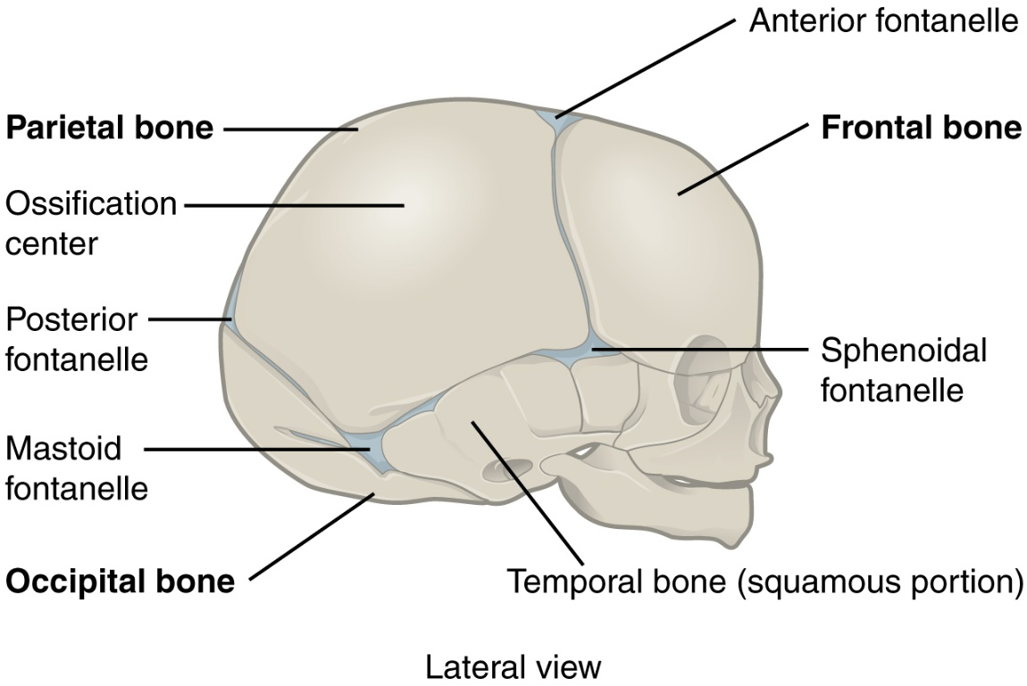
Fibrous joints are defined as the joints in which the bones are connected by fibrous tissue.

Slide 54
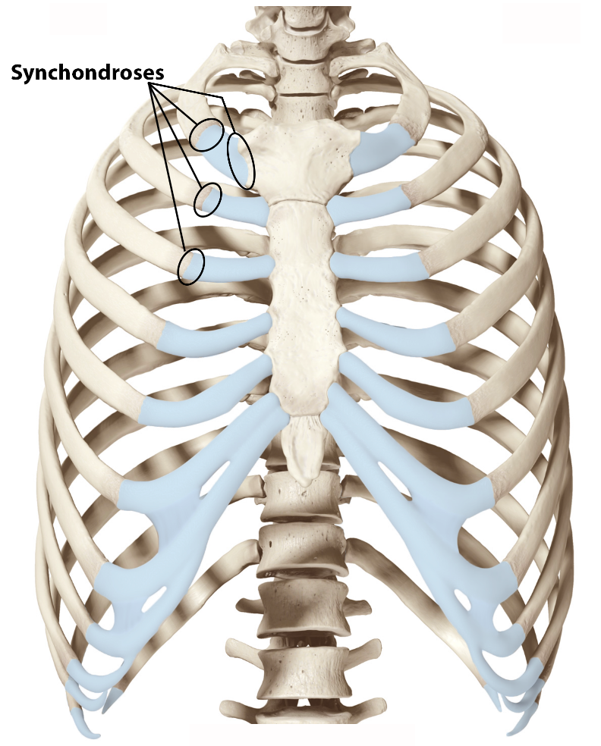
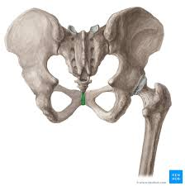

Cartilaginous joints are connected entirely by cartilage: Type 1 and 2

Slide 55

Synovial joints
It is the most common type of joint found in
the human body, and contains several
structures which are not seen in fibrous
or cartilaginous joints.
The six main features of a synovial joints are:
(1) articular capsule
(2) articular cartilage
(3) joint cavity
(4) synovial membrane
(5) synovial fluid
(6) mobility

Slide 56


Slide 57

Bursa is an important lubricated fluid-filled thin sac located between bone and surrounding soft tissue, bones and tendons, and/or muscles around joints, and are useful to the human body by reducing tension and negative effects of wear-and-tear at points of friction and ...

